Slide 1
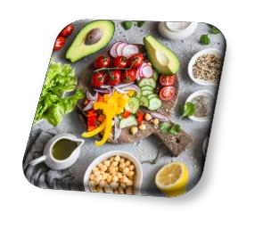

Healthy Eating on the Go
Lee Hyrkas, RD, CDCES, NASM-CPT
Registered Dietitian Performance Nutrition Specialist

Slide 2
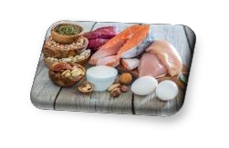
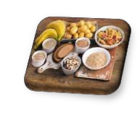
Simple Shopping List
Lean Protein:
Chicken breast
Fish or Tuna packets
Eggs
Natural peanut butter
Greek yogurt or cottage cheese cups
Tofu
Beans (black, kidney, pinto, etc.)
Nut & seed pouches
Kefir
Pea protein milk (Ripple)
Produce:
Fruits (berries, apples, citrus, grapes)
Fresh vegetables (cucumbers, peppers)
Steam bag vegetables
Canned vegetables (beans, etc.)
Frozen fruit
Fruit cups or canned fruit packed in juice
Go Carbs:
Sprouted grain bread
Wraps (Tumaro’s)
Oatmeal
Sweet potatoes, squash
Teff, amaranth, quinoa
Canned beans (black, kidney, etc.)
Palmini noodles
Birch Benders pancake mix
Bean pastas (Banza, lentil)
Healthy Fats:
Nuts & seeds
Avocados (fresh or frozen)
Salad dressing (yogurt based)
Hummus or guacamole
Pasture raised eggs
Natural nut butters

Slide 3

Creating Meal Themes
Crock Pot Monday
Grilling Tuesday
Wild Card Wednesday
Leftover Thursday
Seafood Friday

Slide 4
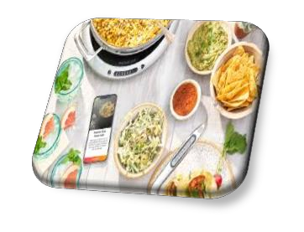
Utilize Your Tools Wisely
Grill for easy clean-up.
Microwave for side dishes.
Crock-pot for freezer bag meals.
Instant Pot® for last minute meals.
Multi-rack steamers for all-in-one cooking.

Slide 5
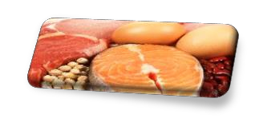
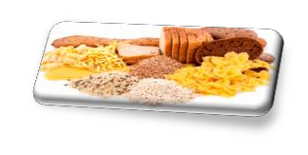
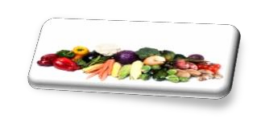
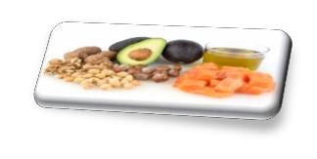
Building Meals
Include at Least 3 Food Groups: Lean Protein
Chicken, lean beef, fish, eggs, beans, etc…
Quality Carbohydrates
Sweet potatoes, sprouted/whole grains, etc…
Fruit & Vegetables
Apples, salad greens, broccoli, berries, etc…
Healthy Fats
Nuts, olive oil, avocados, fish, etc…

Slide 6
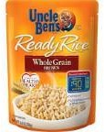
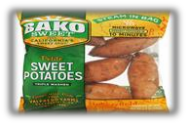
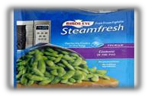
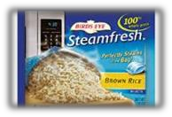
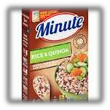
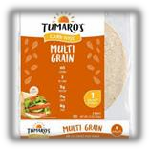
Easy Side Dishes
Stock-up on easy to make sides.
Steam bag potatoes, whole grain breads, wraps, minute
rice, mini bagels, fruit, edamame, etc…
Photos courtesy of Google images

Slide 7
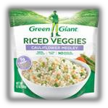
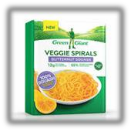
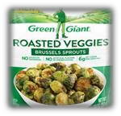
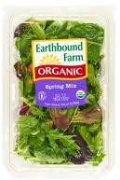
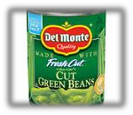
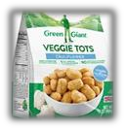
Simple Veggie Options
Use frozen or canned to prevent spoilage.
Stock-up on easy produce options.
Steam bag veggies, spring mix, spiralized veggies, riced
veggies, mashed cauliflower, canned veggies, etc…
Photos courtesy of Google images

Slide 8

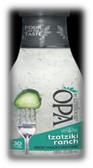
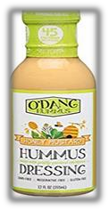
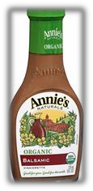
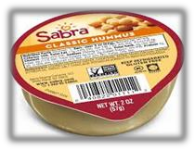
Flavor Enhancers ☺
Have more of these options around the house.
O’Dang, Bolthouse, Skinnygirl, Annie’s, OPA, hummus, guacamole
Photos courtesy of Google images

Slide 9
Healthy Swaps
Original Ingredient | Alternative
Flour Wraps | Low Carb Wraps
White Rice | Brown Rice or Riced Veggies
White Noodles | Edamame Noodles or Barilla Protein
Tater Tots | Veggie Tots
Potatoes | Jicama, Turnip, Rutabaga
Pizza Crust | Whole Wheat Ultra-Thin Crust
Ketchup | Salsa, Tomato Paste or G Hughes Sauce
Heavy Cream | Evaporated Milk or 2% Milk
Breadcrumbs | Panko Breadcrumbs, Oatmeal, Flaxseed
Salad Dressing | Yogurt Based Dressing
Lasagna Noodles | Sliced Zucchini or Eggplant
Full-Fat Cheese | Reduced-Fat Cheese
Ground Beef | Ground Turkey or Chicken (90/10)

Slide 10
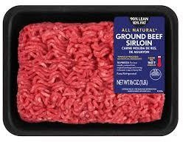
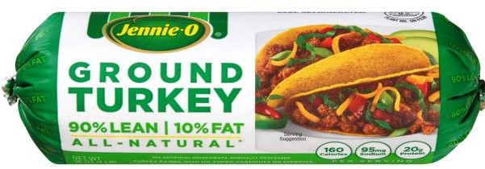
Ingredient Swap
90/10 Beef – 1 lb.
Calories = 800
Fat = 44 g
Saturated Fat = 18 g
Protein = 88 g
90/10 Chicken – 1 lb.
Calories = 640
Fat = 36 g
Saturated Fat = 10 g
Protein = 80 g
Save 160 calories and 8 grams fat!

Slide 11
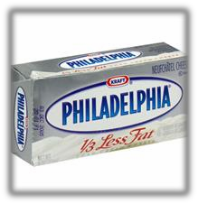

Ingredient Swap
Full-Fat Cream Cheese - 8 oz. Neufchatel Cream Cheese - 8 oz.
Calories = 800
Fat = 71 g
Saturated Fat = 48 g
Protein = 16 g
Calories = 560
Fat = 48 g
Saturated Fat = 32 g
Protein = 16 g
Save 240 calories and 23 grams fat!

Slide 12
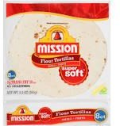
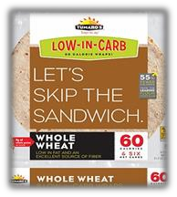
Ingredient Swap
Flour Tortilla
Calories = 140
Fat = 3.5 g
Carbs = 24 g
Fiber = 1 g
Protein = 4 g
Tumaro’s® Wrap
Calories = 60
Fat = 2 g
Carbs = 13 g
Fiber = 7 g
Protein = 5 g
Save 80 calories and gain 6 g fiber!

Slide 13
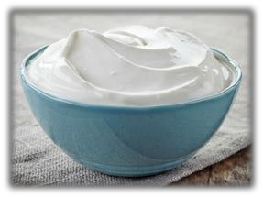
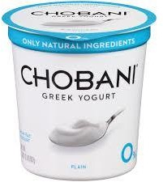
Ingredient Swap
Full Fat Sour Cream - 8 oz.
Calories = 480
Fat = 40 g
Saturated Fat = 28 g
Protein = 8 g
Non-Fat Greek Yogurt - 8 oz.
Calories = 120
Fat = 0 g
Saturated Fat = 0 g
Protein = 22 g
Save 360 calories and 40 grams fat!

Slide 14
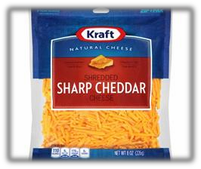
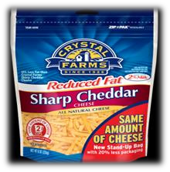
Ingredient Swap
Shredded cheese – 1 cup Reduced-Fat Shredded Cheese – 1 cup
Calories = 440
Total Fat = 36 g
Saturated Fat = 20 g
Protein = 7 g
Calories = 360
Fat = 20 g
Saturated Fat = 12 g
Protein = 8 g
Save 80 calories and 16 grams fat!

Slide 15
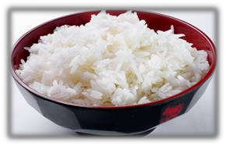
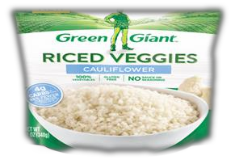
Ingredient Swap
White Rice – 1 cup cooked
Calories = 205
Total Carb = 45 g
Fiber = 0.5 g
Protein = 4 g
Riced Cauliflower – 1 cup
Calories = 20
Total Carb = 4 g
Fiber = 2 g
Protein = 2 g
Save 185 calories and 41 grams carbs!

Slide 16

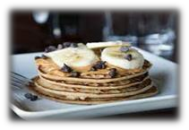
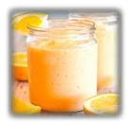
Simplify Breakfast
Meal 1:
2 baked eggs with peppers and spinach
1 English muffin with avocado
1 small bowl melon or berries
Meal 2:
2-3 protein pancakes
Sliced banana or berries
Glass of almond milk
Meal 3:
Sprouted grain English muffin with sunbutter or almond butter
Small container Greek yogurt
Creamiscle® Smoothie:
Orange, 3/4 cup Greek yogurt, 1/2 cup OJ
1/2 banana (sliced and frozen), 1 tsp. vanilla extract

Slide 17
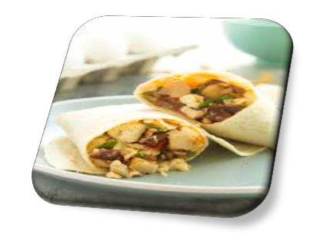
Breakfast Burritos
Eggs or Egg Whites
Breakfast meat (optional)
Chicken links or Canadian bacon
Mixed vegetables
Peppers
Broccoli
Onion
Spinach
Potatoes
Reduced-fat cheese Low carb wrap
Flatout, Mission, Tumaro’s
Adapted From: Allrecipes.com

Slide 18
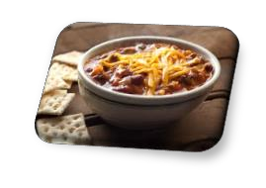
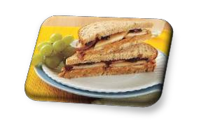
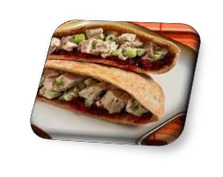
Lunch Ideas
Sample 1:
Bowl of homemade chili or soup
Thin crackers
Piece of fruit or veggies with yogurt dip
Milk or water
Sample 2:
Peanut butter sandwich on bread or low carb wrap
Raw veggies with hummus or guacamole
Greek yogurt cup
Sample 3:
1-2 cups leftover casserole
Veggies with yogurt dip
Water
Sample 4
Pita stuffed with chicken, lettuce, cheese and dried cranberries
10-15 pretzels crisps with hummus
water

Slide 19
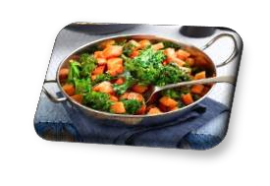
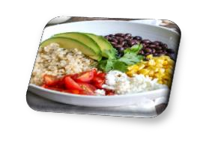
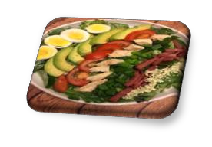
More Lunch Ideas
Sample 1:
Chicken and vegetable stir-fry
1 cup brown jasmine or wild rice
Sample 2: (Bean, Veggie & Grain Bowl)
1 cup cooked quinoa
3/4 cup beans
1/2 avocado
1 cup roasted or stir-fry vegetables
Sample 3:
Cobb Salad
  Diced avocado, eggs, deli turkey, tomatoes and seeds
Piece of fruit or small bowl of melon

Slide 20
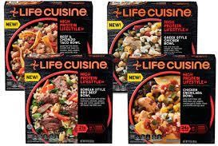
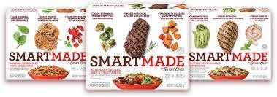
Frozen Entrees
Easy pre-portioned option.
Companies have improved taste and quality.
Minimal preservatives, lower salt, higher protein, more vegetables
SmartMade, EatingWell, Life Cuisine, Power Bowls
What to look for?
High protein (~15 grams or more)
Higher fiber (~2-3 grams or more)
Lower salt (~500-800 mg)
Add fruit and vegetables on the side.

Slide 21
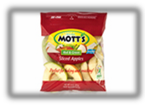



Fueling on the Road
Entrée Ideas:
Grilled chicken sandwich
Single patty burger (~1/4 lb.)
Chicken wrap
Chili
Roast beef sandwich
Omelet
Chicken or turkey sub
Baked or grilled fish
Sirloin or tenderloin steak
Burrito bowl
Chicken or steak fajitas
Beverages:
Water
Milk
Light lemonade
Tea
Coffee
Flavored water
Side Dishes:
Baked potato or mashed potatoes
Baked chips or popcorn
Salad
Fruit plate
Apple slices
Brown or wild rice
Veggie noodles
Soup (broth based)
Edamame
Steam or roasted vegetables
Yogurt or cottage cheese
Condiments:
Ketchup
Mustard
Pickles
Salsa
Oil & vinegar dressing
Peanut butter

Slide 22
Restaurant Swaps
X French fries
X Breaded chicken
X Juice
X Butter
X Salad dressing
X Cream based soups
X Fried fish
X Burger with bun
X Tacos
X Burrito
X Coleslaw
X Thick crust supreme pizza
X Buns
Baked potato or sweet potato
Grilled or baked (skin removed)
Fruit platter
Olive oil or avocado
Yogurt dressing or vinegar & oil
Chili, broth based soups
Baked or broiled (non-breaded)
Turkey burger or veggie burger
Taco salad without the shell
Burrito or grain bowls
Cottage cheese or side salad
Thin crust chicken & vegetable or cheese
Wrap or open faced sandwiches

Slide 23
Keep Snacking Simple!
Lean jerky
Boiled eggs
Peanut butter or nuts
Greek yogurt
String cheese
Dry roasted edamame
Cottage cheese
Protein bars
Lean Protein
Sample Snack
*Greek yogurt cup mixed with Ranch seasoning
*Carrot sticks
Apple, bananas, etc…
Oranges
Fruit cups
Salads
Carrots
Cauliflower or broccoli
Freeze dried fruit
Fruit &
Vegetables

Slide 24
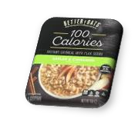
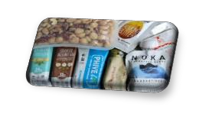
On the go Snacks
Fruit (bananas, apples, oranges, etc.)
Veggies (carrots, celery, etc.)
Dried fruit (dates, raisins, etc.)
Squeezable fruit pouches
Homemade energy bites
Mini bagels
Nut bars (Kirkland, KIND, etc.)
Roasted chickpeas or edamame
100 calorie nut pouches
Bottled protein drinks (Quest, Premier)
Greek yogurt cups
Lean jerky
P3 packs
Trail mixes (fruit, nut, cereal)
Rice cakes
Oatmeal packets
Bada beans
Natural peanut butter
Protein bars (Quest, RX, Built)
Wraps (Tumaro’s, Flatout, etc.)
Hummus or guacamole cups
String cheese
Cottage cheese cups
Boiled eggs
Kefir
100 calorie bags popcorn

Slide 25
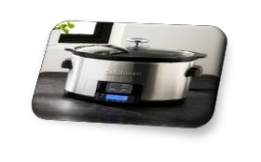


Slow Cooking Devices
Programmable Slow Cooker
Electric Pressure Cooker
Multi-Cookers (Ninja Foodi™)

Slide 26

Crock-Pot Tips ☺
Never cook from frozen!
Thaw freezer meals & meats prior
Cook on low if using dairy products.
Cream, cheese, milk, sour cream, etc…
Prevents dairy products from curdling
Sauté or grill veggies for extra flavor.
Onions, peppers, mushrooms, etc…
Don’t over cook chicken.
5-6 hours on low.
Consider programmable crock-pot.

Slide 27



Essentials
Non-stick spray
Meat thermometer Liners

Slide 28

More on Crock-Pots
Drain and rinse canned vegetables or beans.
Removes excess liquid and salt.
Add leafy greens at the end of cooking.
Spinach, kale, etc…
Thaw frozen veggies before cooking.
Toss in cooked grains at the end of cooking.
15-30 minutes left.

Slide 29

Family Favorites
Buffalo Chicken Soup
Taco Soup
Pulled BBQ Pork or Chicken Chicken Tacos
Balsamic Pork Tenderloin Quinoa Enchilada Casserole

Slide 30

Crock-Pot Recipes
www.skinnytaste.com/recipes/slow-cooker/
www.hungry-girl.com/go-to-guides/slow-cooker-roundup www.budgetbytes.com/category/recipes/slow-cooker/ slenderkitchen.com/search?p=slow+cooker fitfoodiefinds.com/50-healthy-slow-cooker-recipes/

Slide 31

Sheet Pan Meals
Buy a large sheet pan.
At least ~13” x 18”.
Cut root vegetables into smaller pieces.
Potatoes, squash, carrots, etc.
Use parchment paper or foil.
Spray foil with non-stick cooking spray.
Try not to stack ingredients.
Will steam the food instead of roasting it.

Slide 32

Sheet Pan Ideas
Homemade Low Carb Pizza
Sheet Pan Fajitas
Chipotle Lime Shrimp & Vegetables Teriyaki Salmon & Vegetables
Balsamic Chicken & Vegetables

Slide 33
Recipe Websites
Fitmencook.com
Skinnytaste.com Hungry-girl.com Minimalistbaker.com Cookinglight.com Budgetbytes.com

Slide 34

Swaps for Optimal Health
X Reined Grains (White Grains)
X Processed Red Meat
X Juice
X Sweets
X Vegetable Oil
X Chips
X Butter
X Vegetable Dips
X Regular Peanut Butter
X Soft Drinks
X Fast Food
X Refried Beans
X Cold Cereal
Whole Grains (Brown Grains)
Fish, Seafood, Poultry or Wild Game
Whole Fruit
Berries (All Types)
Olive Oil or Avocado Oil
Nuts/Seeds
Avocados
Hummus or Guacamole
Natural Peanut Butter or Sunbutter
Infused Water or Sparkling Water
Home Cooked Meals
Whole Beans (Black, Kidney, Pinto, etc.)
Oatmeal, Quinoa or Amaranth

Slide 35
Lower Carb Swaps
X 12 oz. can soda
X 10 oz. fruit juice
X 1.75 oz. bag chips
X King-size candy bar
X Flavored coffee creamer
X Ice cream bar X 2 slices bread X Bagel
X Vanilla yogurt
X Rice
X Noodles
X Potatoes
X Crackers
Sparkling water, tea or coffee
Piece of fruit
100 calorie bag popcorn or pork rinds
Protein bar (Quest, RX, ThinkThin)
Protein drink (Premier, Quest, Orgain)
Frozen grapes or Halo Top
Tumaro wrap or lettuce wrap
Bagel Thins or mini bagels
Plain Greek yogurt
Riced veggies
Veggie noodles
Mashed cauliflower
Rice cakes or cucumber slices

Slide 36

Whole30 Meal Plan (Paleo)
Minimizes processed foods.
May help determine “trigger foods”. Whole30 Meal Plan:
Lean protein
Healthy fats
Herbs & spices
Non-starchy vegetables & potatoes
whole30.com

Slide 37

Intermittent Fasting 101
Sets specific windows for eating.
May reduce meal stress. Protocols Vary:
5:2 Fasting
Intermittent Fasting (16:8)
Alternate Day Fasting
Experimenting with different protocols is key.

Slide 38

More on Fasting
Stop eating at a consistent time each night.
8 PM, etc…
Brush and mouthwash after your final meal/snack.
Be mindful of food choices at night.
Beta cell production better in the AM
Food thermogenesis lower at night
Photos courtesy of Google images

Slide 39

Fasting Pros & Cons
Pros:
As effective as continuous calorie restriction.
May help curb excessive snacking at night.
Likely improves insulin sensitivity.
May improve lipid levels.
Cons:
Not superior to traditional calorie restriction for weight loss.
May cause certain individuals to binge eat.
Likely not appropriate for certain populations.
  High level athletes, pregnancy, individuals with chronic hypoglycemia or anxiety
Headaches, anxiety, constipation, drop in blood pressure.
examine.com/nutrition/the-low-down-on-intermittent-fasting/

Slide 40
Fasting Example
Male following a 16 fast/8 feeding eating pattern.
Brunch: 11 AM
Burrito Bowl
*4 oz. lean ground beef
*1/2 avocado
*Roasted vegetables
*1/2 cup quinoa
Afternoon Snack 3 PM
*Premier protein drink
*Small bowl berries
*1/4 cup seeds
Supper: 6 PM
*4 oz. BBQ chicken
*1 sweet potato
*Large salad with yogurt dressing
Snack: 7 PM
*Greek yogurt cup
*3-5 cups popcorn

Slide 41

Eat Enough Protein
Tips:
Incorporate plant based options.
Space your intake.
Choose lean animal products.
  Loin, tenderloin, round, skinless, etc.

Slide 42
Daily Protein Guidelines
Conditions | Recommended Amount | Example
Highly Active | 0.7 – 1.0 g/lb./day | 150 lbs. x 0.7 – 1 = ~105 - 150 g protein
Weight Loss or Experienced | 0.5 – 0.7 g/lb./day | 150 lbs. x 0.5 – 0.7 = ~75 - 105 g protein
Inactive Maintenance | 0.4 g/lb./day | 150 lbs. x 0.4 = ~60 g protein
Sources: Bauer, Jürgen et al. Evidence-Based Recommendations for Optimal Dietary Protein Intake in Older People: A Position Paper From the PROT-AGE Study Group. Journal of the American Medical Directors Association , Volume 14 , Issue 8 , 542 - 559
Examine.com

Slide 43



Common Food Sources of Protein
~15-30 grams p
er meal
Popular Choices | Protein Per Serving
3 oz. beef, chicken, pork, etc. | 21 grams
2 eggs | 14 grams
1/2 cup liquid egg whites | 14 grams
5 oz. can tuna | 20 grams
1/2 cup cottage cheese | 14 grams
5.3 oz. Greek yogurt | 14 grams
1 string cheese | 7 grams
6 oz. container yogurt | 6 grams
8 oz. milk | 8 grams
1/2 cup beans | 7 grams
Meatless burger | 10-15 grams
8 oz. soy milk | 8 grams
2 Tbsp. peanut butter | 7 grams
~10-20 grams p
er snack

Slide 44

Important Takeaways
Trial a new recipe weekly.
Choose easy recipes
Focus on food swaps. Eat enough protein daily.
Vary sources (plant, animal, etc.)
Don’t be afraid to experiment.
Everyone's journey is different

Slide 45
References
Almoosawi S, Vingeliene S, Gachon F, et al. Chronotype: Implications for Epidemiologic Studies on Chrono-Nutrition and Cardiometabolic Health. Adv Nutr. 2019;10(1):30–42. doi:10.1093/advances/nmy070
Israetel, M., DR., Davis, M., DR., Case, J., DR., & Hoffmann, J., DR. (n.d.). The Renaissance Diet 2.0.
https://examine.com/nutrition/the-low-down-on-intermittent-fasting/ https://sciencebasedmedicine.org/intermittent-fasting/
https://www.strongerbyscience.com/chrononutrition/

