Slide 1
Prelaunch Checklist
What to do and when to do it!
timothy.shirk@francisinvco.com
Pre-launch Checklist
getting ready for

Slide 2
moneyadviceatwork.com/foth
Your employer sponsors this great benefit!
Sales-free money advice
Confidential with no jargon or judgment
Any money topic is on the table
No copays, part of 401(k) fees

Slide 4
This is your launch date!

Slide 5
Every year
10-15 years to go
5-10 years to go
Retirement
Prelaunch
Checklist
3-5 years to go
1 year to go
At retirement
At age 72

Slide 6
Meet with money advisor
Run retirement projection
Verify accuracy of assumptions
Every Year

Slide 7
Run projection – define target date
10-15 Years
To Go

Slide 8
Run projection – define target date
Begin downshift in portfolio risk
10-15 Years
To Go

Slide 9
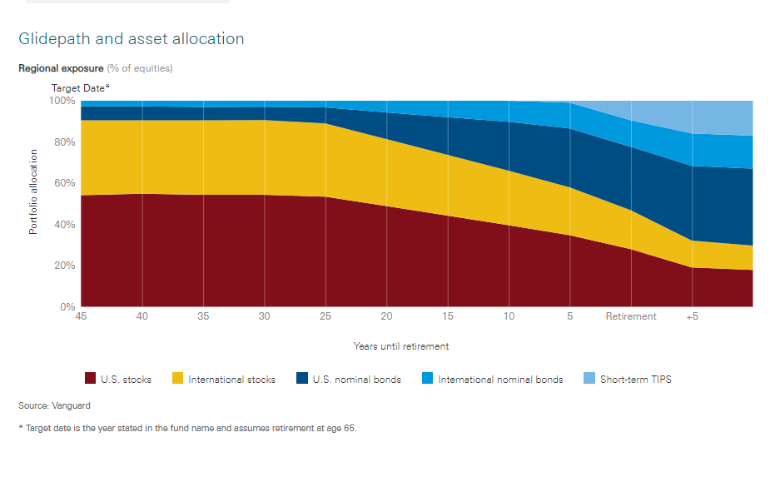
Begin downshift in risk profile
Illustration represents the Vanguard Target Retirement Funds.
Not a specific recommendation, for illustration purposes only.

Slide 10
Run projection – define target date
Begin downshift in portfolio risk
Consider a shift from Roth to pre-tax
10-15 Years
To Go
Every situation is unique, seek qualified tax advice. Francis Investment Counsel does not provide tax advice.

Slide 11
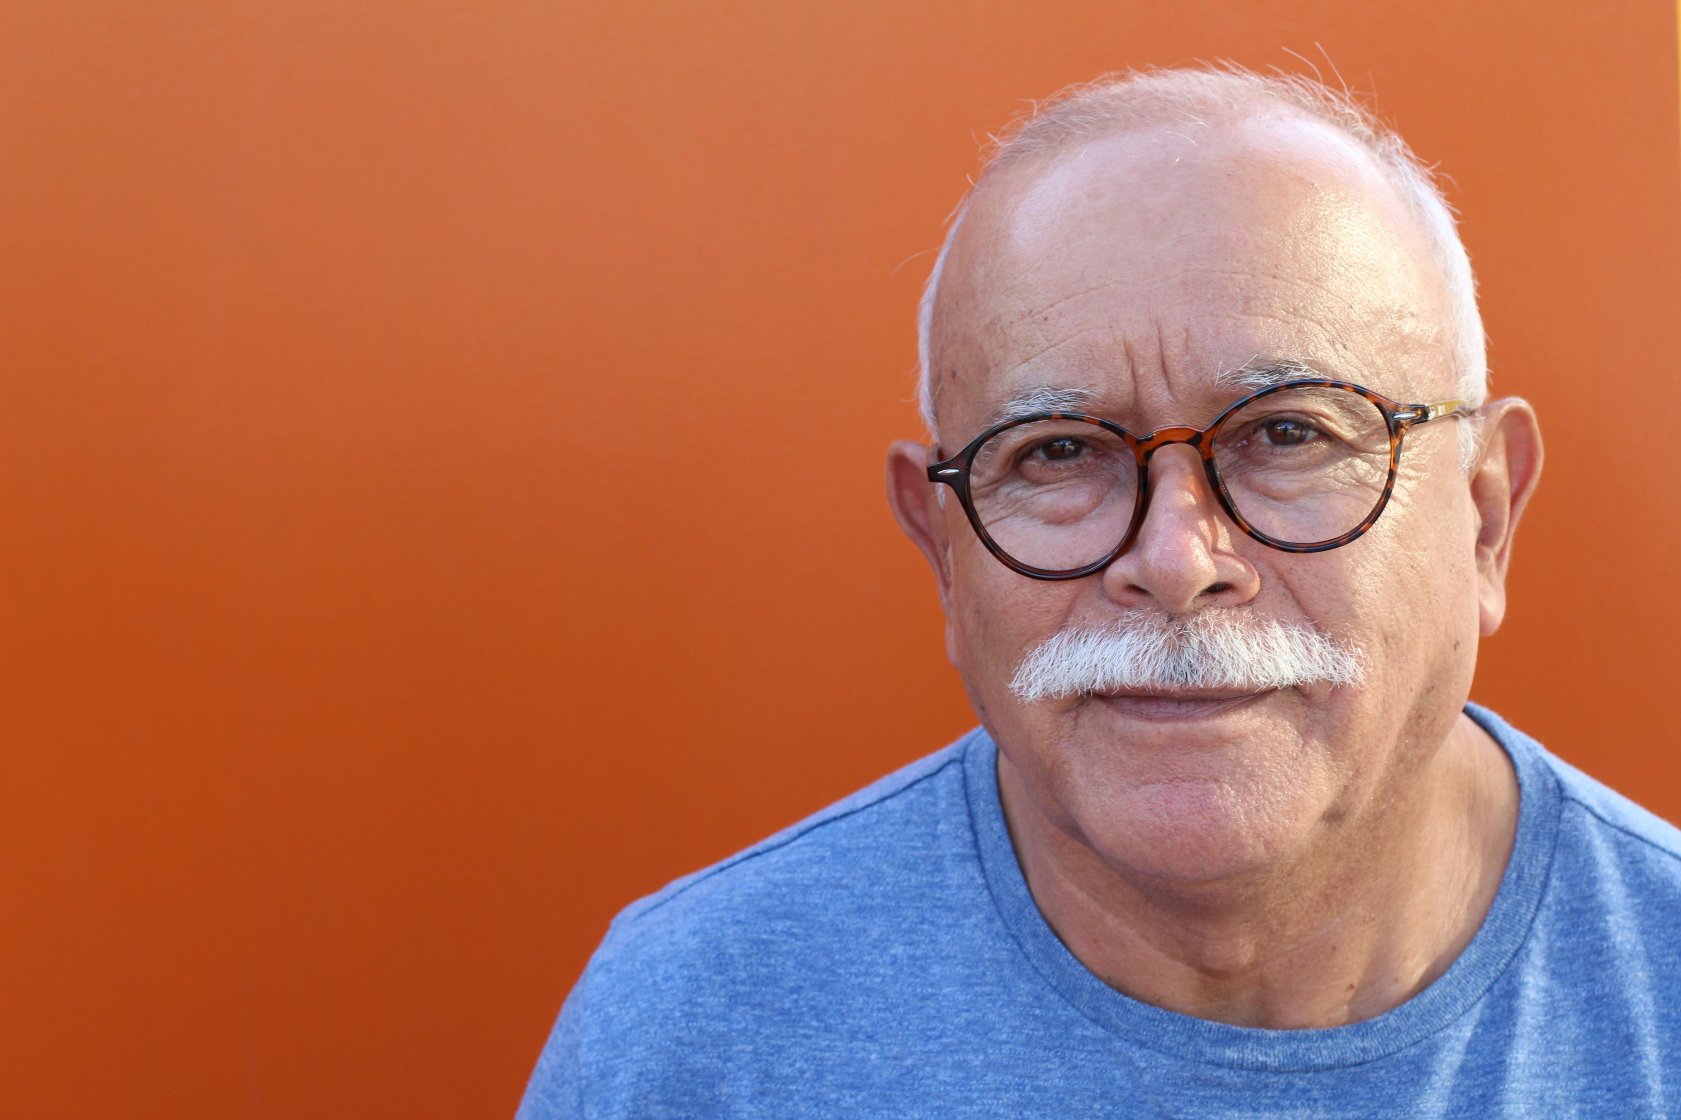
Consider shift from Roth to pretax
Roth is a tax break on growth
Pretax is a tax break on contribution
Every situation is unique, seek qualified tax advice. Francis Investment Counsel does not provide tax advice.

Slide 12
Run projection – define target date
Begin downshift in portfolio risk
Consider a shift from Roth to pre-tax
Verify debt free by retirement
10-15 Years
To Go

Slide 13
Run projection – define target date
Begin downshift in portfolio risk
Consider a shift from Roth to pre-tax
Verify debt free by retirement
Build HSA balance
10-15 Years
To Go

Slide 14
Build HSA balance
Tax free contributions
Tax free growth
Tax free distributions (for qualified medical expenses)
https://www.irs.gov/publications/p969

Slide 15
Build HSA balance
Max out HSA contributions
Pay for current expenses out of pocket
Retain receipts for potential reimbursement
Invest balance based on investment horizon
https://www.irs.gov/publications/p969

Slide 16
Run projection – define target date
Begin downshift in portfolio risk
Consider a shift from Roth to pre-tax
Verify debt free by retirement
Build HSA balance
Convert kids costs to financial priorities
Consider catch up contributions
10-15 Years
To Go
Notes:
.

Slide 17
Define retirement lifestyle
5-10 Years
To Go

Slide 18
Define retirement lifestyle
Where you will live
Lifestyle you desire
Activities

Slide 19
Define retirement lifestyle
Estimate income need
5-10 Years
To Go

Slide 20
Estimate income need
Top down
Current income
Minus non-retirement expenses
Plus, increased expenses
Bottom up
Build retirement budget
Don’t forget increased costs

Slide 21
Define retirement lifestyle
Estimate income need
Project Social Security and pension
5-10 Years
To Go

Slide 22
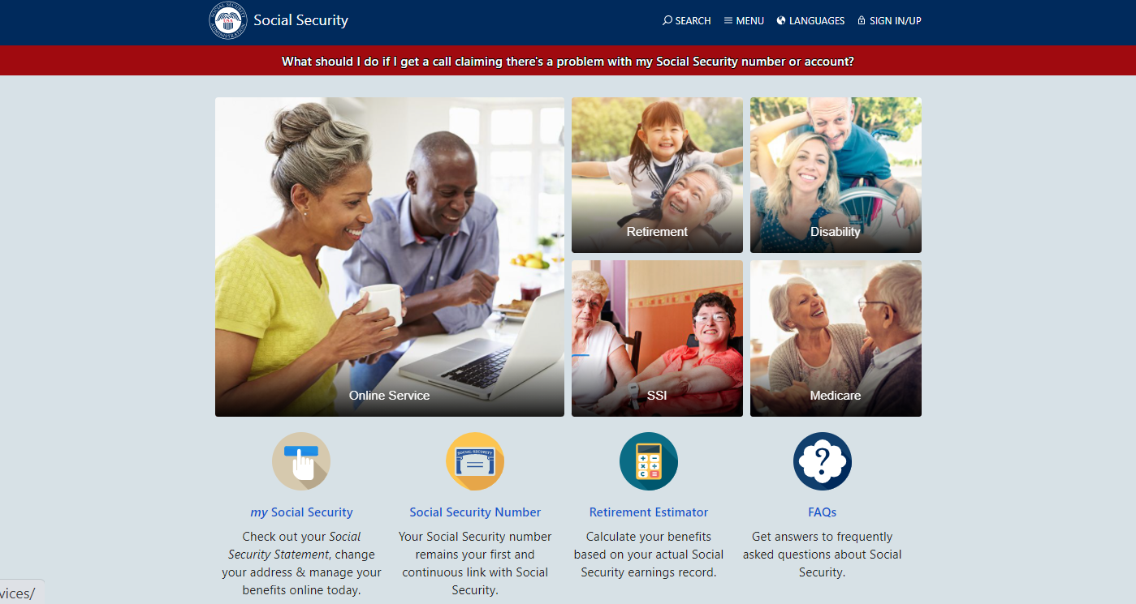

Slide 23
Define retirement lifestyle
Estimate income need
Project Social Security and pension
Start building retirement cash position
5-10 Years
To Go

Slide 24
Start building retirement account cash position
3 – 5 Years of Needed Income
Moderate
Stock/Bond Mix
Cash Bucket
Growth Bucket

Slide 25
Define retirement lifestyle
Estimate income need
Project Social Security and pension
Start building retirement cash position
Consider opening a Roth IRA
5-10 Years
To Go

Slide 26
Consider opening a Roth IRA
Every situation is unique, seek qualified tax advice. Francis Investment Counsel does not provide tax advice.

Slide 27
Consider financial management plan
3-5 Years
To Go

Slide 28
Will you continue to invest or buy a promise?
Continued Investment
IRA or Company Plan
Allows for continued growth
Allows for a more moderate position
Purchase of a promise
Purchase of immediate annuity
Insures against running out of money
Requires more conservative position
Notes:
.”

Slide 29
Corporate Retirement Plan or IRA?

Slide 30
Consider financial management plan
Consider long term care insurance
3-5 Years
To Go

Slide 31
Consider long term care insurance
60 is generally better than 50
Can you self-insure?
Focus on benefit size over duration
Beware of the impact of inflation
www.longtermcare.gov

Slide 32
Consider financial management plan
Consider long term care insurance
Update Social Security and Pension
3-5 Years
To Go

Slide 33
Asset allocation at retirement level
1 Year
To Go

Slide 34
Land asset allocation at retirement level.
Illustration represents the Vanguard Target Retirement Funds.
Not a specific recommendation, for illustration purposes only.

Slide 35
Asset allocation at retirement level
Interview and select an advisor
1 Year
To Go

Slide 36
Interview and select an advisor
Fiduciary vs. salesperson
Look for “Fee Only” structure
Consider CFP® certificate holder
Review experience and disciplinary history
www.letsmakeaplan.org (CFP®)
www.finra.org (Broker)
www.sec.gov (Advisor)

Slide 37
Asset allocation at retirement level
Interview and select an advisor
Consolidate retirement accounts
1 Year
To Go

Slide 38
Consolidate multiple accounts
May reduce fees
Makes asset allocation simpler
Allows for simpler withdrawals

Slide 39
Asset allocation at retirement level
Interview and select an advisor
Consolidate retirement accounts
Determine Social Security file date
1 Year
To Go

Slide 40
Determine Social Security file date
Apply for benefits 4 months in advance of start date
Visit local Social Security office
Apply online
(unless survivor benefits)
www.ssa.gov

Slide 41
Asset allocation at retirement level
Interview and select an advisor
Consolidate retirement accounts
Determine Social Security file date
Familiarize yourself with Medicare
1 Year
To Go

Slide 42
https://www.medicare.gov/pubs/pdf/10050-medicare-and-you.pdf

Slide 43
Eligible for Medicare at
age 65

Slide 44
What About Before Age 65?
National Healthcare Exchange (Obamacare)
COBRA
Private Insurance

Slide 45
What the “Parts” Mean
Part A – Hospital Insurance
Part B – Medical Insurance
Part C – Medicare Advantage Plans
Part D – Prescription Drug Coverage

Slide 46
Medicare
Pays
You
Pay
https://www.medicare.gov/what-medicare-covers/what-part-a-covers

Slide 47
Medicare
Advantage
Original
Medicare
Part A
Part B
Medigap (includes D)

Slide 48
Initial enrollment period
3 months < 65 | 2 months < 65 | 1 month < 65 | Month you turn 65 | 1 Month > 65 | 2 months > 65 |  | 3 months > 65
Sign up to avoid a delay in coverage |  |  | If you wait, coverage will be delayed for:
 |  |  | 1 month | 2 months |  | 3 months

Slide 49
Asset allocation at retirement level
Interview and select an advisor
Consolidate retirement accounts
Determine Social Security file date
Familiarize yourself with Medicare
Finalize income strategy
1 Year
To Go

Slide 50
How Long Will Your Money Last?
Pull out 8% per year –
Money lasts 14 years
Pull out 7% per year –
Money lasts 16 years
Pull out 6% per year –
Money lasts 20 years
Pull out 5% per year –
Money lasts 25 years
Pull out 4% per year –
Money lasts 30 years
Assumes 5% annual return and 3% annual increase in withdrawal for inflation adjustment. For illustration purposes only.

Slide 51
At
Retirement

Slide 52
Begin required minimum distributions
At
Age 72

Slide 53
Begin required minimum distributions
Transfer Roth 401(k) to Roth IRA
At
Age 72

Slide 54
Roll your Roth 401(k) into a Roth IRA
Roth 401(k)s are subject to RMDs
Roth IRAs are not
https://www.irs.gov/retirement-plans/plan-participant-employee/retirement-topics-required-minimum-distributions-rmds
Every situation is unique. Seek qualified tax advice. Francis Investment Counsel does not provide tax advice.

Slide 55
Begin required minimum distributions
Transfer Roth 403(b) to Roth IRA
Consider Qualified Charitable Distribution
At
Age 72

Slide 56
Qualified charitable distributions (QCD)
Distribution from an IRA (not SEP or Simple IRA)
Over 70.5 years old
Paid directly from IRA to qualified charity
Can satisfy the required minimum distribution
https://www.irs.gov/retirement-plans/retirement-plans-faqs-regarding-iras-distributions-withdrawals
Every situation is unique, seek qualified tax advice. Francis Investment Counsel does not provide tax advice.

Slide 57
Prelaunch Checklist
What to do and when to do it!
timothy.shirk@francisinvco.com
Pre-launch Checklist
getting ready for

Slide 58
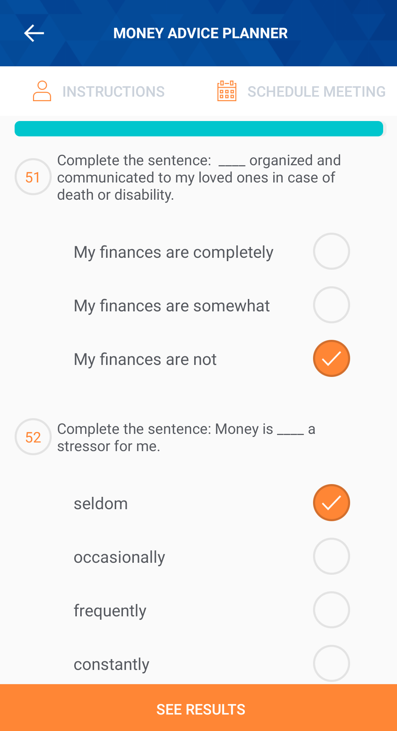
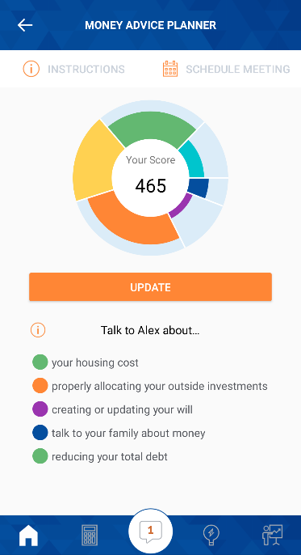
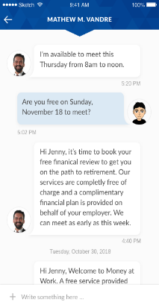
MoneyAdvice@Work® Mobile App
GET STARTED
Learn your top five financial priorities with the Money Advice Planner (MAP)
GAME-PLAN
Get customized recommendations based on your MAP score
CONNECT
Meet with your Money Advisor to create a plan
KEEP GOING!
Celebrate the goals you accomplish! Then, keep going!

